Slide 1
Unit 2: For Live Session Assignment

Slide 2
Put each on its own slide(s) and include your code!
Download into R Studio the PlayerBBall.csv dataset. This data set is every NBA basketball player from 1950 to present. It contains their height, weight, position and the year they played (among other data.) (Position: F-Forward, C-Centers, F-C and C-F – Forward /Centers, G – Guards, F-G – Forward/Guards) FYI: If you feel that these questions are open ended or at least a little vague, this is on purpose. Answer the question as you understand it and make any assumptions you need to make ot answer the question and record those assumptions.
Use the PlayerBBall.csv dataset to visually represent (summarize) the number of players in each position.
Use the dataset to visually investigate the distribution of the weight of centers (C) is greater than the distribution of the weight of forwards (F).
Use the dataset to visually investigate if the distribution of the height of centers (C) is greater than the distribution of the height of forwards (F).
Use the dataset to visually investigate if the distribution of height is different between any of the positions.
Use the dataset to investigate how the player’s height is related to the player’s weight. How does height change as the weight changes?
Is their any difference in the relationship between height and weight between positions? Are height and weight related differently for different positions.
A historian would like to investigate the claim that the heights of players have increased over the years. Analyze this claim graphically / visually.
Create a 3D plot of height vs. weight vs. year started and color code the points by position.
Go to this website and use one of the 50 best plots to visualize some aspect of the data and provide at least one insight. You will present your work in breakout! http://r-statistics.co/Top50-Ggplot2-Visualizations-MasterList-R-Code.html
Separate dataset: The EducationIncome.csv dataset has incomes of randomly selected Americans and their level of education.
Visually test the claim that the distribution of incomes increase (mean or median) as the education level rises.

Slide 3
Data Wrangling!
# read
PB = read.csv(file.choose(), header = TRUE)
# Clean
#F-C and C-F and F-G and G-F
PB$position2 = if_else(PB$position == "C-F","F-C",PB$position)
PB$position2 = if_else(PB$position == "G-F","F-G",PB$position2)
#Identify Missing Position Row ...
which(PB$position == "")
PB[2143,] #It is George Karl!
#George Karl Point Guard (https://en.wikipedia.org/wiki/George_Karl)
PB[2143,]$position2 = "G"
PB[2143,]$height = "6-2"
PB[2143,]
#Make a Factor variable and Reorder the Level
PB$position2 = factor(PB$position2, levels = c("C","F","F-C","F-G","G"))

Slide 4
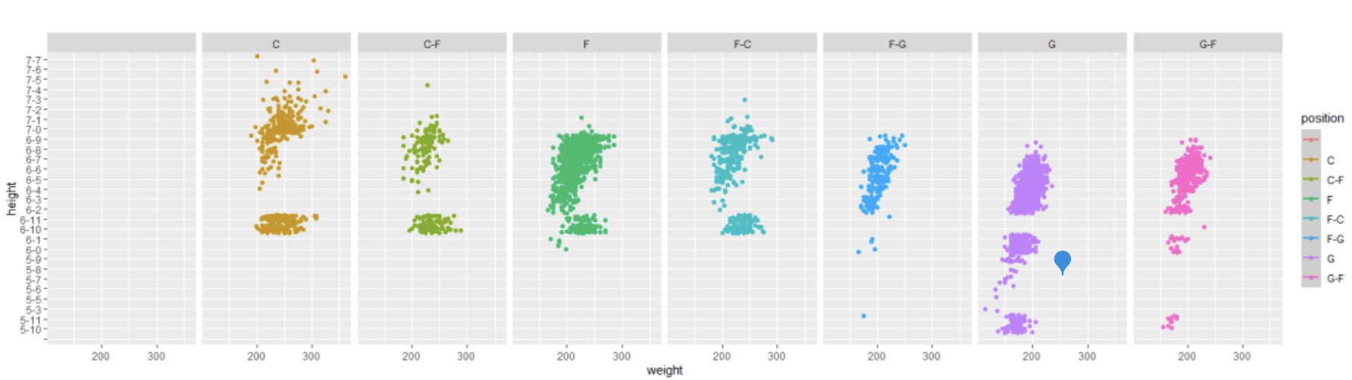
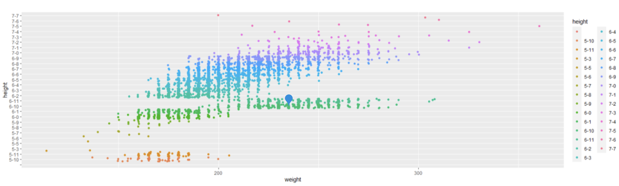
Problem With Factor Levels

Slide 5
Data Wrangling!
# read
PB = read.csv(file.choose(), header = TRUE)
# Clean
#F-C and C-F and F-G and G-F
PB$position2 = if_else(PB$position == "C-F","F-C",PB$position)
PB$position2 = if_else(PB$position == "G-F","F-G",PB$position2)
#Identify Missing Position Row ...
which(PB$position == "")
PB[2143,] #It is George Karl!
#George Karl Point Guard (https://en.wikipedia.org/wiki/George_Karl)
PB[2143,]$position2 = "G"
PB[2143,]$height = "6-2"
PB[2143,]
#Make a Factor variable and Reorder the Level
PB$position2 = factor(PB$position2, levels = c("C","F","F-C","F-G","G"))
PB$height2 = factor(PB$height, levels = c("5-3","5-4","5-5","5-6","5-7","5-8","5-9","5-10","5-11","6-0","6-1","6-2","6-3","6-4","6-5","6-6","6-7","6-8","6-9","6-10","6-11","7-0","7-1","7-2","7-3","7-4","7-5","7-6","7-7"))
# Sanity Check to Make Sure all is well
summary(PB$position2)
summary(PB$height2)

Slide 6
Break Out 1
Questions 1,2 and 3

Slide 7
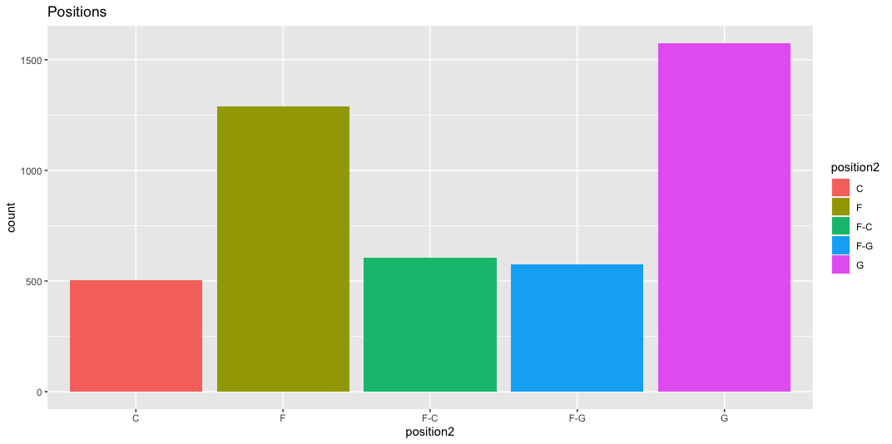
For Live Session: Question 1
Use the PlayerBBall.csv dataset to visually represent (summarize) the number of players in each position.
PB %>% ggplot(aes(x = position2, fill = position2)) + geom_bar() + ggtitle("Positions") + xlab("Position")

Slide 8
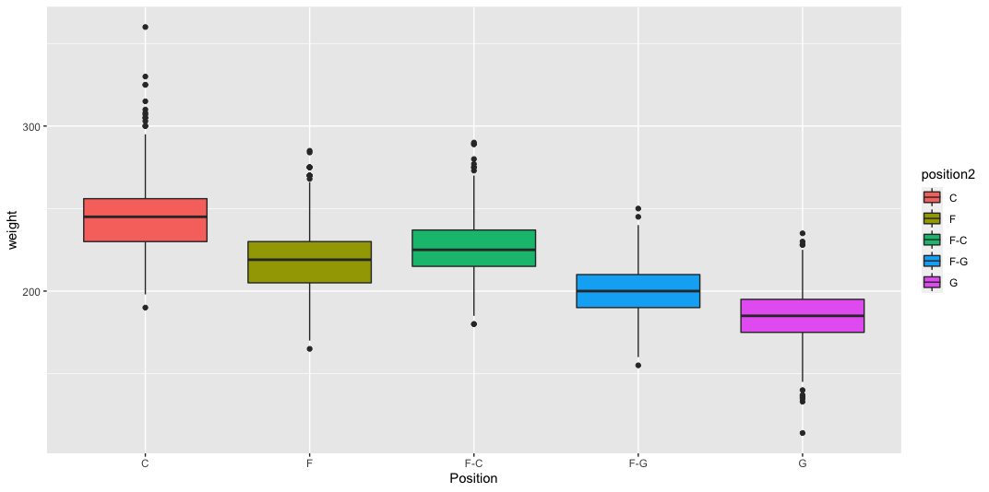
For Live Session: Question 2
Use the dataset to visually investigate the distribution of the weight of centers (C) is greater than the distribution of the weight of forwards (F).
PB %>% ggplot(aes(x = position2, y = weight, fill = position2)) + geom_boxplot() + xlab("Position")
Position

Slide 9
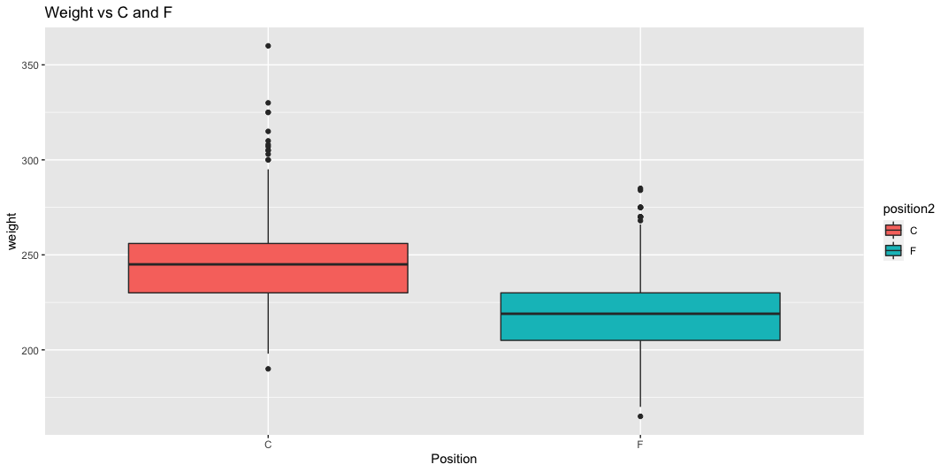
For Live Session: Question 2
Use the dataset to visually investigate the distribution of the weight of centers (C) is greater than the distribution of the weight of forwards (F).
PB %>% filter(position2 == "C" | position2 == "F") %>% ggplot(aes(x = position2,y = weight, fill = position2)) + geom_boxplot() + xlab("Position") + ggtitle("Weight vs C and F")

Slide 10
For Live Session: Question 2
Use the dataset to visually investigate the distribution of the weight of centers (C) is greater than the distribution of the weight of forwards (F).
PB %>% filter(position == "C" | position == "F") %>% ggplot(aes(x = weight, fill = position)) + geom_histogram() + facet_wrap(~position) + ggtitle("Weigth: C vs. F")

Slide 11
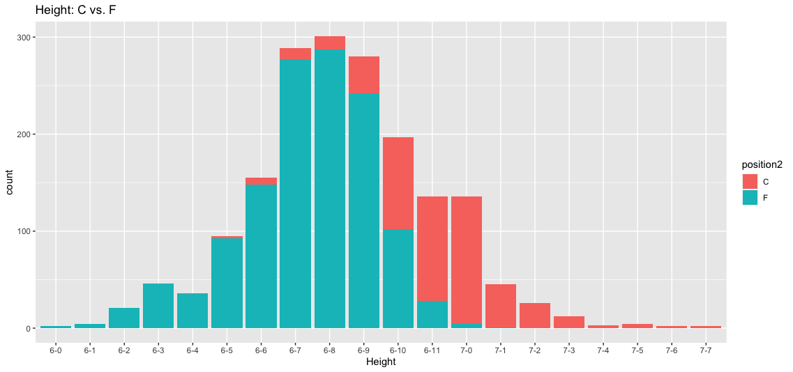
For Live Session: Question 3A
Use the dataset to visually investigate if the distribution of the height of centers (C) is greater than the distribution of the height of forwards (F).
PB %>% filter(position2 == "C" | position2 == "F") %>% ggplot(aes(x = height2, fill = position2)) + geom_bar() + ggtitle("Height: C vs. F") + xlab("Height")

Slide 12
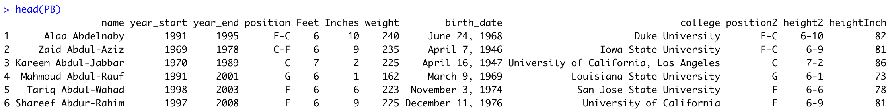
Question 3B
#New Material: Make Height numeric
PB = PB %>% separate("height",c("Feet","Inches"), sep = "-")
head(PB)
PB$Feet = as.numeric(PB$Feet)
PB$Inches = as.numeric(PB$Inches)
PB$heightInch = 12*PB$Feet + PB$Inches
head(PB)

Slide 13
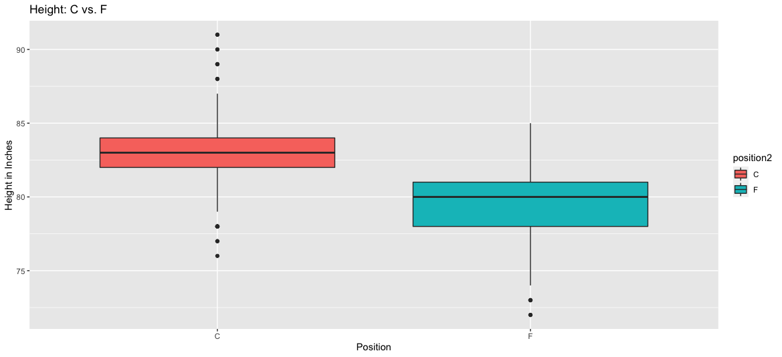
Question 3B
PB %>% filter(position2 == "C" | position2 == "F") %>% ggplot(aes(x = position2, y = heightInch, fill = position2)) + geom_boxplot() + ggtitle("Height: C vs. F") + xlab("Position") + ylab("Height in Inches")

Slide 14
End Break Out 1
Questions 1,2 and 3

Slide 15
Break Out 2
Question 4, 5 and 6

Slide 16
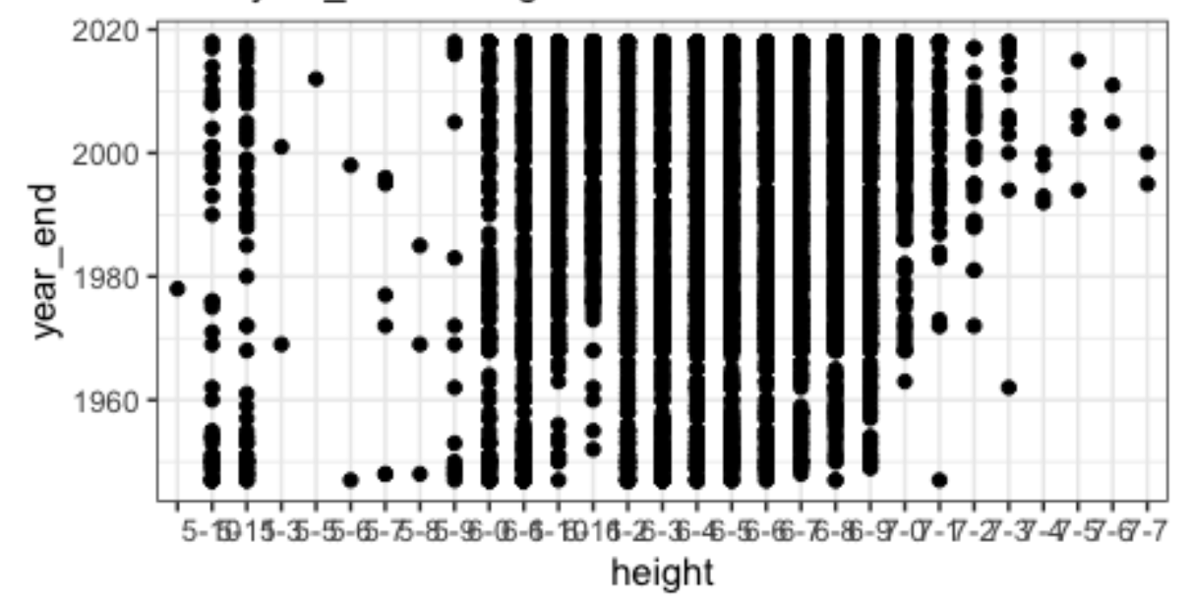
Problem With Labels

Slide 17
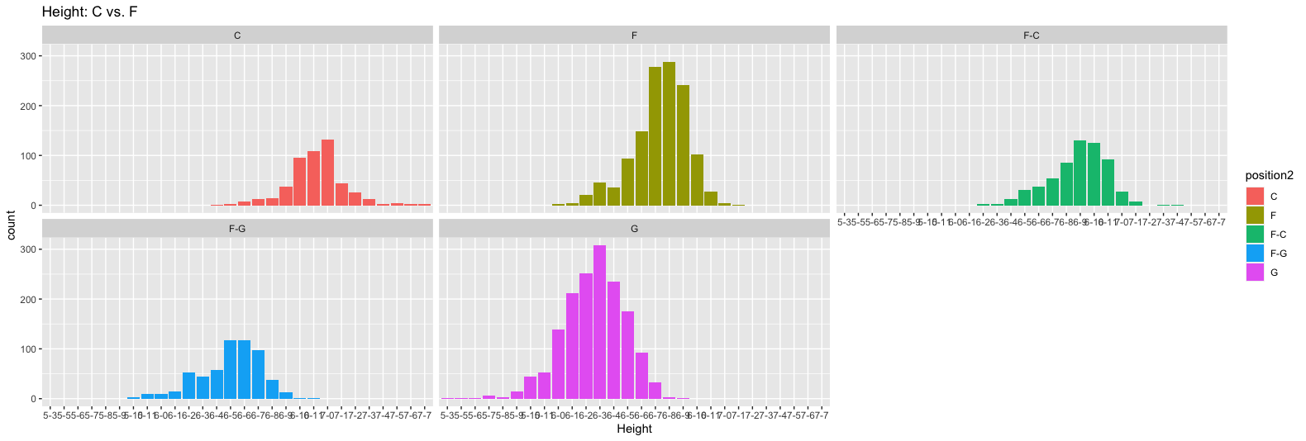
For Live Session: Question 4A
Use the dataset to visually investigate if the distribution of height is different between any of the positions.
PB %>% ggplot(aes(x = height2, fill = position2)) + geom_bar() + ggtitle("Height: C vs. F") + facet_wrap(~position2) + xlab("Height")

Slide 18
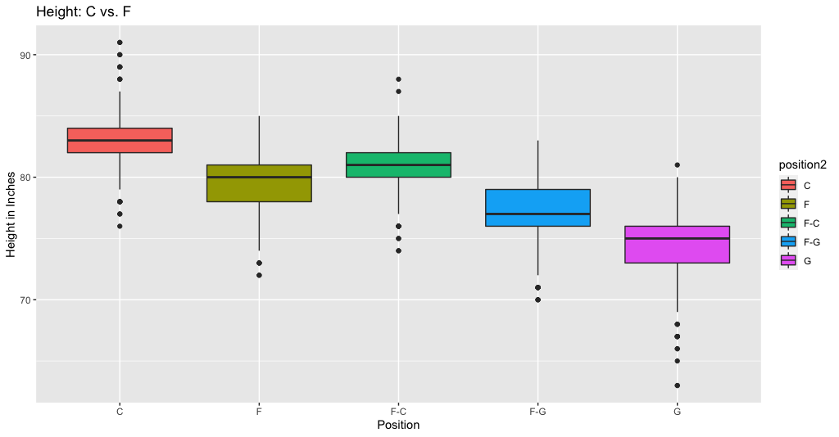
For Live Session: Question 4B
Use the dataset to visually investigate if the distribution of height is different between any of the positions.
PB %>% ggplot(aes(x = position2, y = heightInch, fill = position2)) + geom_boxplot() + ggtitle("Height: C vs. F") + xlab("Position") + ylab("Height in Inches")

Slide 19
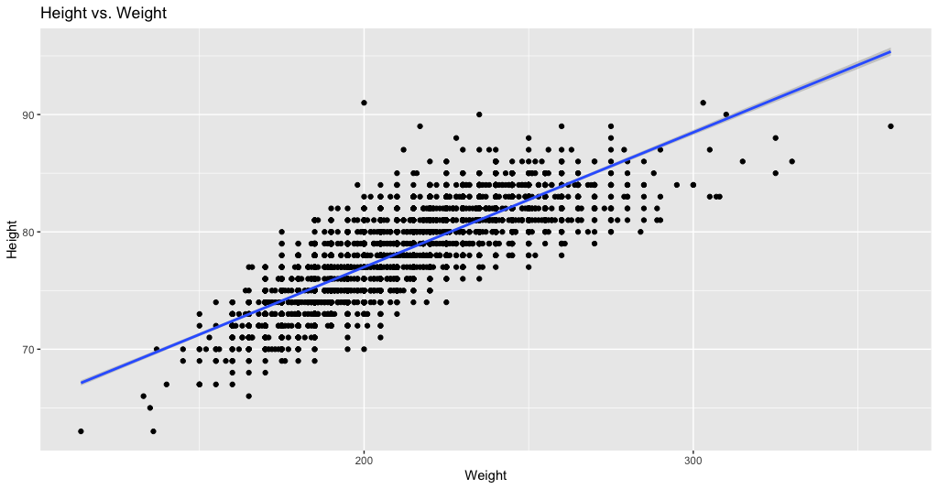
For Live Session: Question 5
Use the dataset to investigate how the player’s height is related to the player’s weight. How does height change as the weight changes?
PB %>% ggplot(aes(x = weight, y = heightInch)) + geom_point() + geom_smooth(method = "lm") + ggtitle("Height vs. Weight") + xlab("Weight") + ylab("Height")

Slide 20
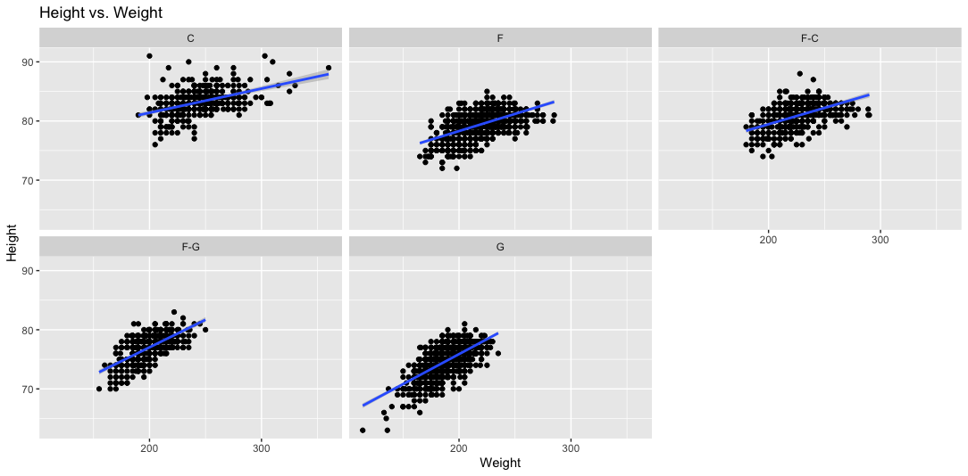
For Live Session: Question 6
Use the dataset to investigate how the player’s height is related to the player’s weight. How does height change as the weight changes?
PB %>% ggplot(aes(x = weight, y = heightInch)) + geom_point() + geom_smooth(method = "lm") + ggtitle("Height vs. Weight") + xlab("Weight") + ylab("Height") + facet_wrap(~position2)

Slide 21
End Break Out 2
Question 4, 5 and 6

Slide 22
Break Out 3
Question 7

Slide 23
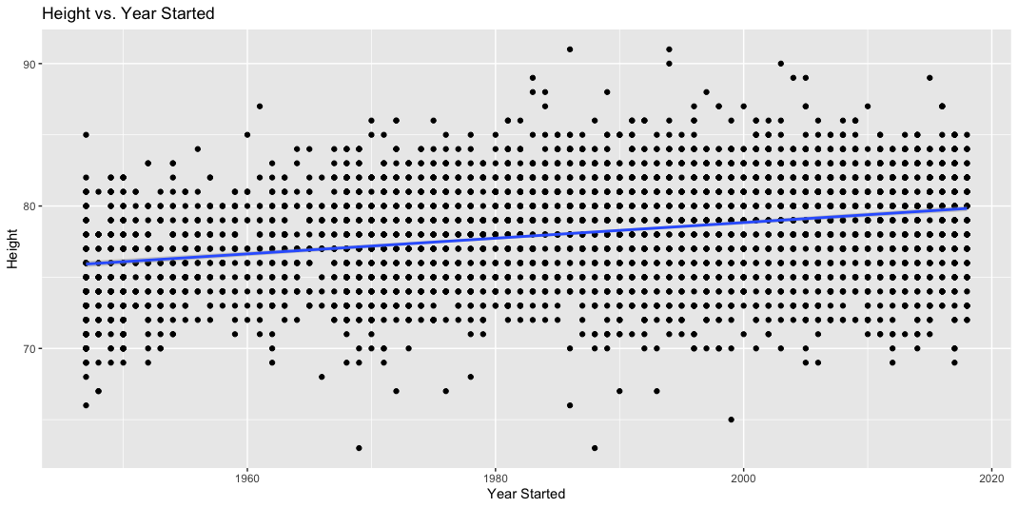
For Live Session: Question 7
A historian would like to investigate the claim that the heights of players have increased over the years. Analyze this claim graphically / visually.
PB %>% ggplot(aes(x = year_start, y = heightInch)) + geom_point() + geom_smooth(method = "lm") + ggtitle("Height vs. Year Started") + xlab(”Year Started") + ylab("Height")

Slide 24
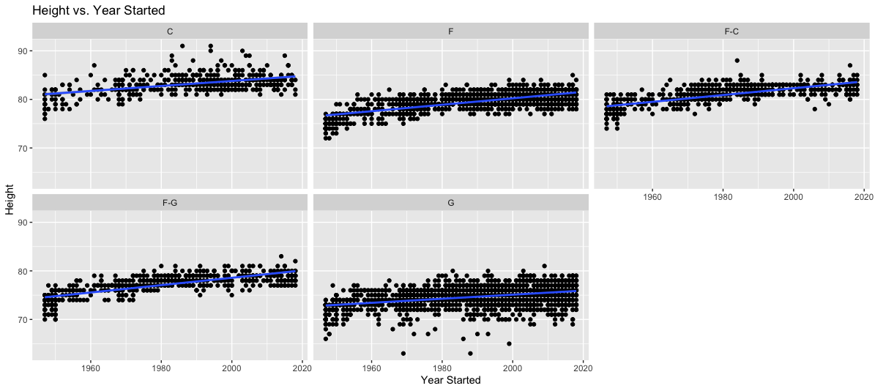
For Live Session: Question 7
A historian would like to investigate the claim that the heights of players have increased over the years. Analyze this claim graphically / visually.
PB %>% ggplot(aes(x = year_start, y = heightInch)) + geom_point() + geom_smooth(method = "lm") + ggtitle("Height vs. Year Started") + xlab("Year Started") + ylab("Height") + facet_wrap(~position2)

Slide 25
End Break Out 3
Question 7

Slide 26
Break Out 4
Question 8

Slide 27
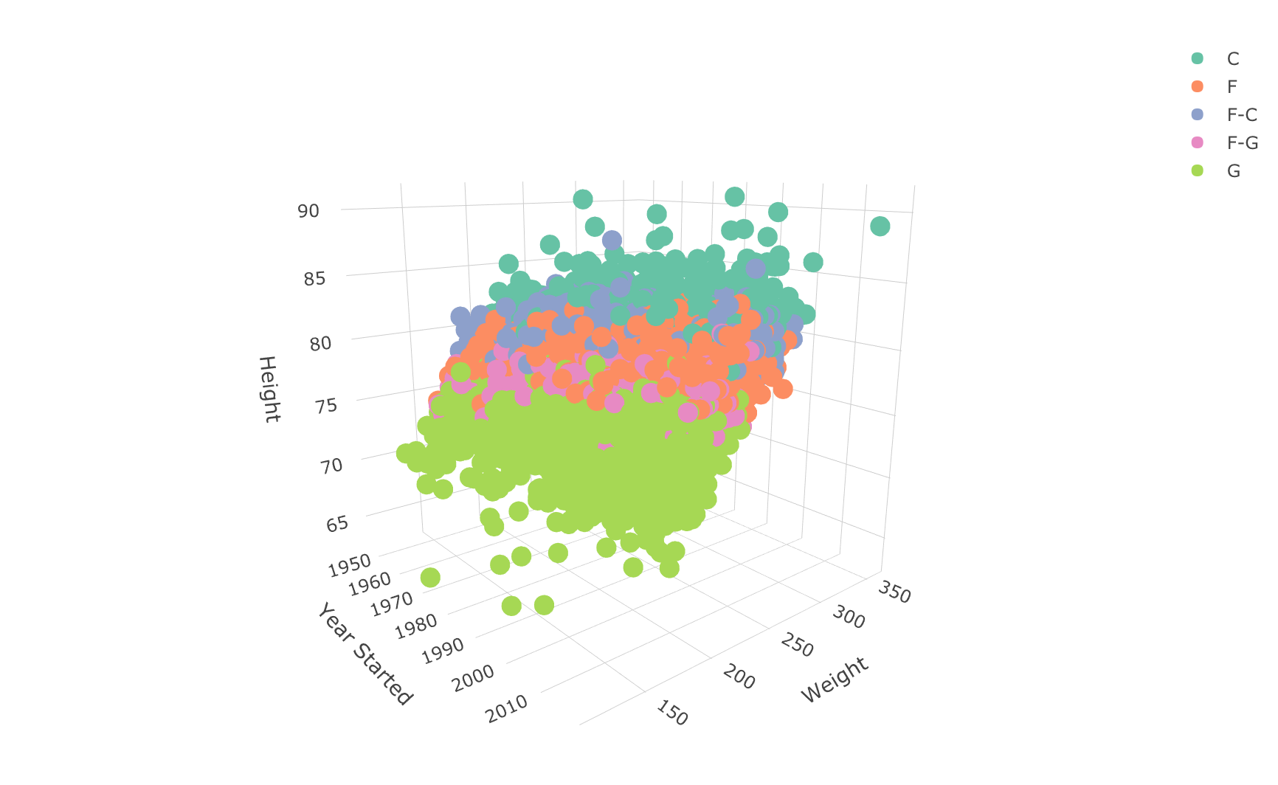
For Live Session: Question 8
Create a 3D plot of height vs. weight vs. year and color code the points by position.
plot_ly(PB, x = ~year_start, y = ~weight, z = ~heightInch, color = ~position) %>%
add_markers() %>%
layout(scene = list(xaxis = list(title = 'Year Started'),
yaxis = list(title = 'Weight'),
zaxis = list(title = 'Height')))

Slide 28
End Break Out 4
Question 8

Slide 29
Break Out 5
Question 9

Slide 30
For Live Session: Question 9
Go to this website and use one of the 50 best plots to visualize some aspect of the data and provide at least one insight. You will present your work in breakout! http://r-statistics.co/Top50-Ggplot2-Visualizations-MasterList-R-Code.html

Slide 31
For Live Session: Question 9
Go to this website and use one of the 50 best plots to visualize some aspect of the data and provide at least one insight. You will present your work in breakout! http://r-statistics.co/Top50-Ggplot2-Visualizations-MasterList-R-Code.html
library(ggplot2)
library(gganimate)
library(gapminder)
library(gifski)
library(png)
p <- ggplot(
PB,
aes(x = weight, y=heightInch, size = weight, colour = position)
) +
geom_point(show.legend = FALSE, alpha = 0.7) +
scale_color_viridis_d() +
scale_size(range = c(2, 12)) +
labs(x = "Weight", y = "Height")
p
p + transition_time(year_start) +
labs(title = "Year: {frame_time}")
https://www.datanovia.com/en/blog/gganimate-how-to-create-plots-with-beautiful-animation-in-r/

Slide 32
End Break Out 5
Question 9

Slide 33
Break Out 6
Question 10

Slide 34
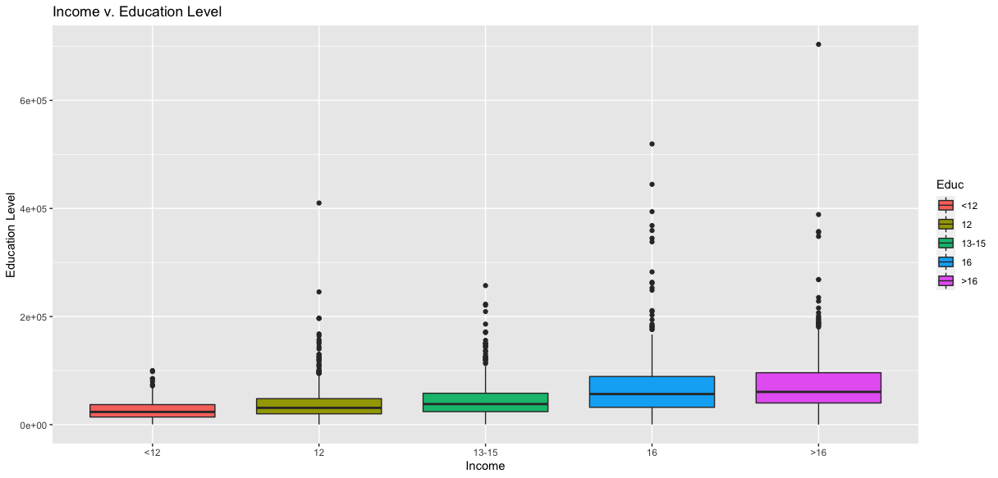
For Live Session: Question 10
Visually test the claim that the distribution of incomes increase (mean or median) as the education level rises.
EI %>% ggplot(aes(x = Educ, y = Income2005, fill = Educ)) + geom_boxplot() +ggtitle("Income v. Education Level") + xlab("Income") + ylab("Education Level")

Slide 35
Break Out 6
Question 10

Slide 36
BONUS: Rmarkdown to PowerPoint
https://support.rstudio.com/hc/en-us/articles/360004672913-Rendering-PowerPoint-Presentations-with-RStudio

Slide 37
Don’t Forget Your Takeaways and Questions!

